Slide 1

“Brain Tumor Detection Using Deep Learning”
Department Of Computer Science and Engineering Jawaharlal Darda Institute of Engineering & Technology, Yavatmal, (M.S), India-445001 Session 2023-2024
Presented by :
Mr. Chetan A. Muneshwar
Mr. Raunak J. Pipariya
Mrs. Shreya N. Nathile
Mr. Amit Khandare
Guided by :
Prof. M. K. Popat

Slide 2
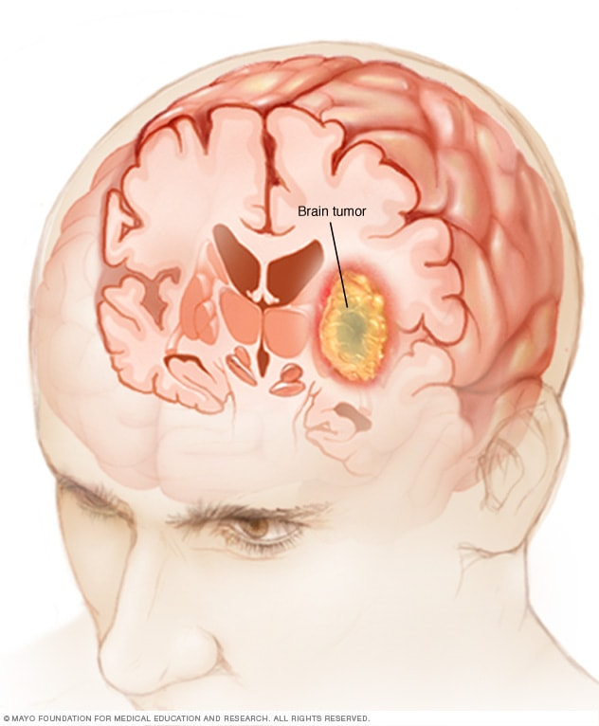
CONTENT:
Abstract
Introduction
Literature Review
Problem Statement
Objective
Research Methodology
System Requirement
Advantages
Conclusion
References

Slide 3
ABSTRACT:
Brain tumor detection is a critical aspect of modern healthcare, as early diagnosis and accurate localization are vital for effective treatment and patient outcomes. Deep learning techniques have shown remarkable potential in addressing this challenge. This study presents a novel approach for brain tumor detection using deep learning mechanism.
We employ a convolutional neural network (CNN) architecture that is tailored to analyze medical images, specifically magnetic resonance imaging (MRI) scans. The model is trained on a large dataset of annotated MRI images, enabling it to learn intricate patterns and features indicative of brain tumors. The CNN's multi-layered structure enables it to automatically extract relevant features, minimizing the need for handcrafted feature engineering.
Results demonstrate the effectiveness of the proposed approach, achieving high accuracy and sensitivity in brain tumor detection. This approach not only aids in early diagnosis but also offers the potential for real-time detection and localization, contributing to improved treatment planning. The use of deep learning in brain tumor detection holds promise for enhancing healthcare outcomes and reducing the burden on radiologists, paving the way for more efficient and accurate diagnosis and treatment of brain tumors.
Keywords: Brain tumor detection, Deep learning, Convolutional neural network (CNN), Medical images, Healthcare, Magnetic resonance imaging (MRI)

Slide 4
INTRODUCTION:
Brain: The brain is largest and most complex organ in human body that serves as the center of the nervous system.
Tumor: A tumor is tissue that is growing where it should not be. Another name of tumor is neoplasm. A tumor is usually form as lump or mass. Tumors are either malignant(harmful) or benign(safe) tumors. Cancer for examples is malignant and sometime spreads to other places on body. Tumor can occur in many different parts of the brain, and it may be classified as primary tumor or secondary tumor.
Brain Tumor: A brain tumor is a growth of abnormal cells in the brain. The anatomy of the brain is very complex, with different parts responsible for different nervous system functions. Brain tumors can develop in any part of the brain or skull, including its protective lining, the underside of the brain (skull base), the brainstem, the sinuses and the nasal cavity, and many other areas. There are more than 120 different types of tumors that can develop in the brain, depending on what tissue they arise from.

Slide 5
Our project has been classified into two broad categories.
1. Patients with brain tumor
2. Patient with no Brain tumor
We have further classified Brain tumor into three main Categories
Glioma
Meningioma
Pituitary
A Brain tumor is considered as one of the aggressive diseases, among children and adults.
Brain tumor account for 85 to 90 percent of all primary Central Nervous System(CNS) tumor.
Every year, around 11,700 people are diagnosed with a brain tumor.
Proper treatment, planning, and accurate diagnostics should be implemented to improve the life expectancy of the patients.
The best technique to detect brain tumors is Magnetic Resonance Imaging (MRI). A huge amount of image data is generated through the scans.
Application of automated classification techniques using Machine Learning(ML) and Artificial Intelligence(AI) has consistently shown higher accuracy than manual classification. Hence, proposing a system performing detection and classification by using Deep Learning Algorithms would be helpful to doctors around the world.

Slide 6
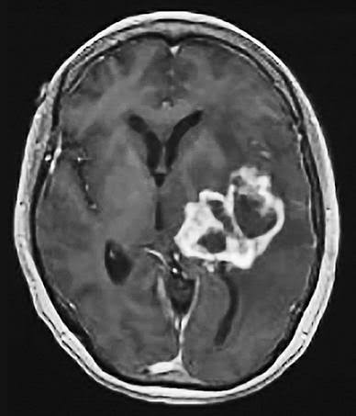
1. Glioma:
A glioma is a tumor that forms when glial cells grow out of control. Normally, these cells support nerves and help your central nervous system work. Gliomas usually grow in the brain, but can also form in the spinal cord.Gliomas are malignant (cancerous), but some can be very slow growing.
They’re primary brain tumors, meaning they originate in the brain tissue. Gliomas don’t usually spread outside of the brain or spine, but are life-threatening because they can:
Be hard to reach and treat with surgery.
Grow into other areas of the brain.

Slide 7
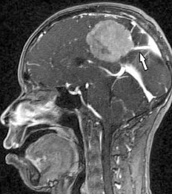
2. Meningioma:
Meningioma is the most common type of primary brain tumor, accounting for approximately 30 percent of all brain tumors.
These tumors originate in the meninges, which are the outer three layers of tissue between the skull and the brain that cover and protect the brain just under the skull.
Meningiomas grow out of the middle layer of the meninges called the arachnoid. They grow slowly and may exist for years before being detected. Sometimes doctors will discover a meningioma incidentally on a magnetic resonance imaging (MRI) scan of the head or spinal cord.
Meningiomas are treatable.

Slide 8
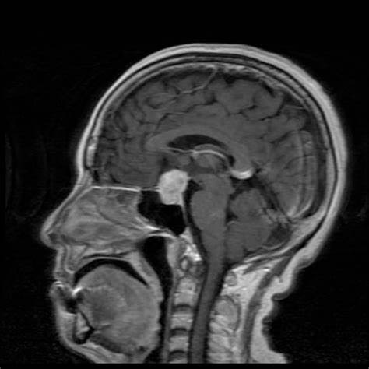
3. Pituitary:
Pituitary tumor is an abnormal growth in the pituitary gland. The pituitary is a small gland in the brain. It is located behind the back of the nose. It makes hormones that affect many other glands and many functions in your body.
Most pituitary tumors are not cancerous (benign).
They don’t spread to other parts of your body.
But they can cause the pituitary to make too few or too many hormones, causing problems in the body.

Slide 9
LITERARTURE REVIEW : Image Analysis for MRI Based Brain Tumor Detection and Feature Extraction Using Biologically Inspired BWT and SVM - In this paper using MR images of the brain, we segmented brain tissues into normal tissues such as white matter, gray matter, cerebrospinal fluid (background), and tumor-infected tissues. We used pre-processing to improve the signal-to-noise ratio and to eliminate the effect of unwanted noise. We can used the skull stripping algorithm its based on threshold technique for improve the skull stripping performance. A Survey on Brain Tumor Detection Using Image Processing Techniques - This paper surveys the various techniques that are part of Medical Image Processing and are prominently used in discovering brain tumors from MRI Images. Based on that research this Paper was written listing the various techniques in use.

Slide 10
Identification of Brain Tumor using Image Processing Techniques - This paper survey of Identifying brain tumors through MRI images can be categorized into four different sections; pre-processing, image segmentation , Feature extraction and image classification .
Review of Brain Tumor Detection from MRI Images - In this paper, some of the recent research work done on the Brain tumor detection and
segmentation is reviewed. Different Techniques used by various researchers to detect the brain Tumor from the MRI images are described. By this review we found that automation of brain tumor detection and Segmentation from the MRI images is one of the most active Research areas .

Slide 11
PROBLEM STATEMENT:
The current system has certain problems in Brain tumor detection. It's important to note that advancements and changes may have occurred in the field of brain tumor detection since then, some of the ongoing challenges that were present at that time are Limited Access to High Quality Data, Ongoing Model Maintenance, False Positives and Negatives, Data Imbalance, Model Interpretability, Regulatory Compliance, etc.
To solve this problems we can simply use Deep Learning to detect brain tumor.

Slide 12
OBJECTIVE:
Brain tumor at early stage is very difficult task for doctors to identify.
MRI images are more prone to noise and other environmental interference.
So, it becomes difficult for doctors to identify tumor and their causes.
So here we come up with the system, where system will detect brain tumor from images.

Slide 13
RESEARCH METHODOLOGY:
The system will have mainly five modules.
Dataset: In dataset we can take multiple MRI images and take one as input image
Pre-processing: In pre-processing image to encoded the label and resize the image.
Split the data: In split the data we set the image as Training Data and Testing Data.
Build CNN model: To train Deep Neural network for classification.
Classification: Used to classify the Brain tumor

Slide 14
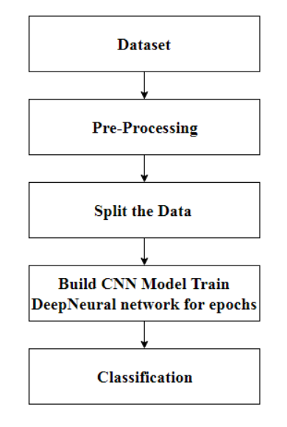
Flowchart:
START
END

Slide 15
SYSTEM REQUIREMENT:
Software Requirement:
Windows 10 / Windows 11
Python
Pycharm

Slide 16
ADVANTAGES:
Accuracy:
MRI images provide detailed and accurate information about the brain, making them an effective tool for detecting brain tumor.
Non-invasive:
MRI scans are non-invasive, meaning they do not require any surgical procedures or injections.
Visualization:
Flask provides a flexible framework for building web-based interfaces.

Slide 17
CONCLUSION:
In our study, we utilized a dataset of Brain MRI images and applied four Convolutional Neural Network (CNN) models for the task of classifying the scans into four different classes: Glioma, Meningioma, No tumor, and Pituitary. The purpose was to evaluate the performance of these models in accurately identifying brain tumor.

Slide 18
REFERENCES:
Minu Samantaray, Millee Panigrahi, K.C. Patra, Avipsa S. Panda, Rina Mahakud “An adaptive filtering technique for brain tumor analysis and detection” 2016 10th International Conference on Intelligent Systems and Control (ISCO)
2. Sneha Grampurohit, Venkamma Shalavadi, Vaishnavi R. Dhotargavi, Megha Kudari, Mrs Soumya Jolad “BRAIN TUMOR DETECTION USING DEEP LEARNING MODELS” 2020 IEEE India Council International Subsections Conference (INDISCON)
3. Avigyan Sinha, Aneesh R P, Malavika Suresh, Nitha Mohan R, Abinaya D, Ashwin G Singerji “Brain Tumor Detection Using Deep Learning” 2021 Seventh International conference on Bio Signals, Images, and Instrumentation (ICBSII)
4. S. Pereira, A. Pinto, V. Alves, C.A. Silva. (2016). “Brain tumor segmentation using convolutional neural networks in MRI images”, IEEE transactions on medicalimaging,pp.1240-1251, 2016. https://doi.org/10.1109/TMI.2016.2538465.
5. X.W. Gao, R. Hui, Z. Tian. (J2017). “Classification of CT brain images based on deep learning networks, Computer methods and programs in biomedicine”,pp.49-56,Jan2017. https://doi.org/10.1016/j.cmpb.2016.10.007.

Slide 19
ANY QUESTIONS !!!

